Slide 1
Overview of R Graphics and ggplot2
Data Visualization Workshop @ Scientific Computing Day
Matthew D. Turner
Georgia State University
mturner46@gsu.edu

Slide 2
Preliminaries

Slide 3
Setup
I am assuming that:
You have used R at least a little bit before today
You have R installed
You are using Rstudio as your interface to R
You should also have followed the instructions in the email:
These commands need to be entered in the command window for R inside of RStudio
These commands only need to be run once (assuming they work!)
They must be run while your computer is connected to the internet
install.packages("tidyverse", dependencies = TRUE)
install.packages("gcookbook")

Slide 4
Setup
IMPORTANT NOTE!!
Due to a webpage formatting issue, the double quote marks in the commands were formatted with quotes that are incompatible with R. If these commands failed for you, try typing them in directly. Then they should work!
I am assuming that:
You have used R at least a little bit before today
You have R installed
You are using Rstudio as your interface to R
You should also have followed the instructions in the email:
These commands need to be entered in the command window for R inside of RStudio
These commands only need to be run once (assuming they work!)
They must be run while your computer is connected to the internet
install.packages("tidyverse", dependencies = TRUE)
install.packages("gcookbook")

Slide 5
Setup
You should also download the materials for the workshop today:
Github: fork the repo, then clone your copy locally
Or as a zip file:
https://github.com/theEducationalCollective/2018-Scientific-Computing-Day-Visualization-Workshop
http://bit.ly/scd2018git
http://bit.ly/scd2018zip

Slide 6
Setup: Two Important Things
Rstudio allows you to change its working directory to the location of the file you are using from the RStudio menu (at top)
You should do this for each of the files from the workshop today when you load a new one
Failure to do this may break the file, if that happens, just go to the menu change the working directory and try again
You need to load the ggplot library before using it
This can be done in two ways. Use one of the following commands:
library(ggplot2)
library(tidyverse)
This will be done in the examples files, but you have to run the files in order if you skip around you may need to remember this!

Slide 7
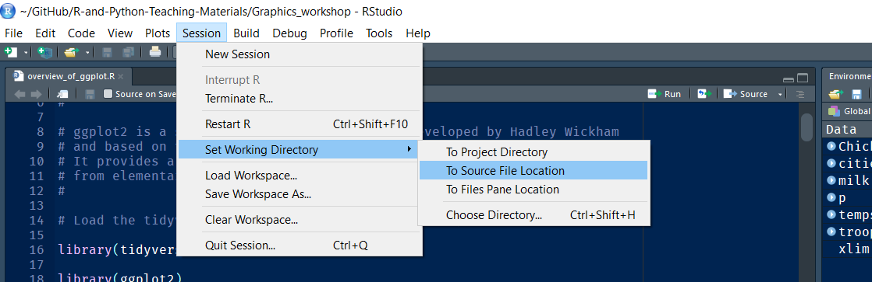
Setup: Two Important Things
Rstudio allows you to change its working directory to the location of the file you are using from the RStudio menu (at top)
You should do this for each of the files from the workshop today when you load a new one
Failure to do this may break the file, if that happens, just go to the menu change the working directory and try again
You need to load the ggplot library before using it
This can be done in two ways. Use one of the following commands:
library(ggplot2)
library(tidyverse)
This will be done in the examples files, but you have to run the files in order if you skip around you may need to remember this!

Slide 8
Setup: Two Important Things
Rstudio allows you to change its working directory to the location of the file you are using from the RStudio menu (at top)
You should do this for each of the files from the workshop today when you load a new one
Failure to do this may break the file, if that happens, just go to the menu change the working directory and try again
You need to load the ggplot library before using it
This can be done in two ways. Use one of the following commands:
library(ggplot2)
library(tidyverse)
This will be done in the examples files, but you have to run the files in order if you skip around you may need to remember this!
Notes:
Note the 2!!

Slide 9
On to ggplot

Slide 10
R Plotting Systems
R has three plotting systems:
Base R Graphics
Lattice Graphics
ggplot2
Most people start with the base R graphics system
I will assume you have used this a little bit
The ggplot2 system is built on top of it
We’ll focus on the ggplot2 system today because it is the easiest way to get good quality figures easily for a wide variety of types of data

Slide 11
Note
Some of the examples I will be using today come from a set of online notes from a course at IDRE at UCLA
The course has slides at: stats.idre.ucla.edu/stat/data/intro_ggplot2/ggplot2_intro_slidy.html
The full set of materials for the UCLA workshop is at: stats.idre.ucla.edu/r/seminars/ggplot2_intro/
The presentation here will be somewhat simpler and assume less experience with R
The UCLA workshop is a good follow-up for more

Slide 12
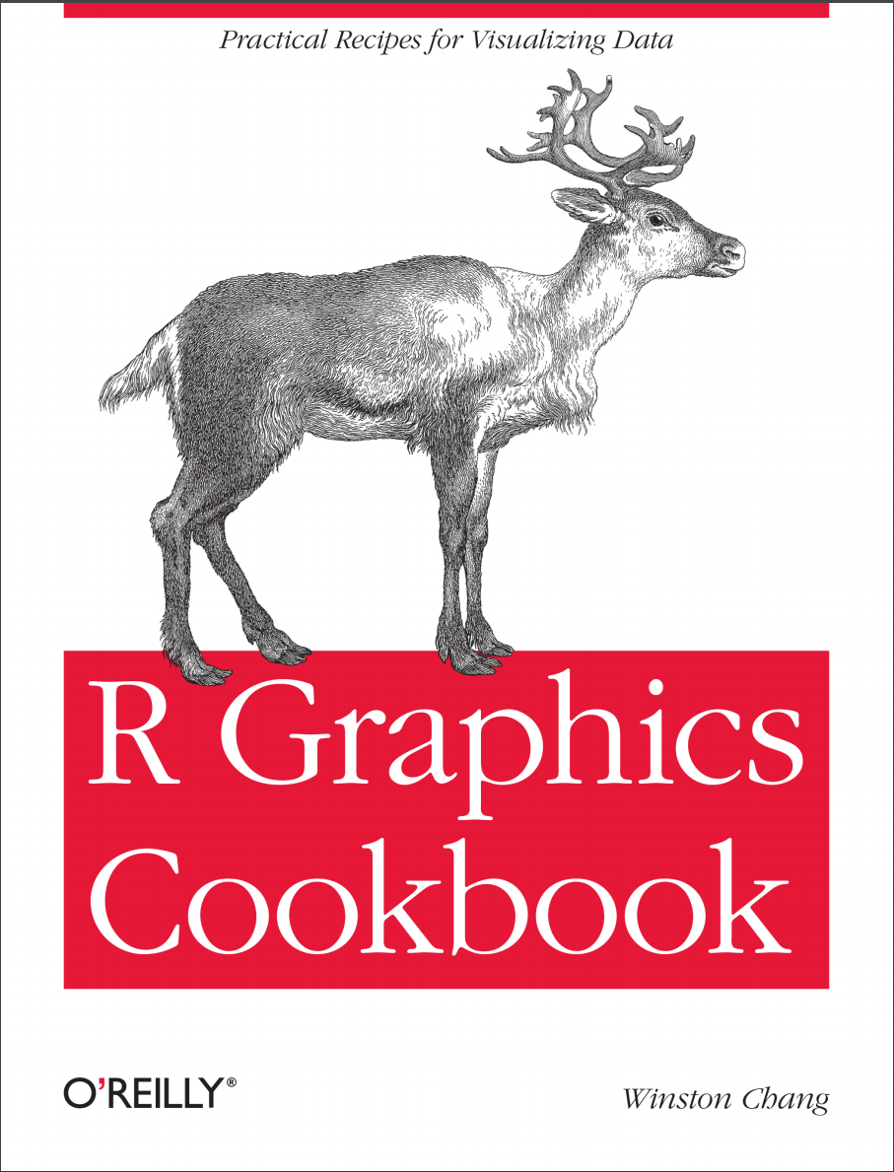
Another good resource for ggplot and R graphics generally is Winston Chang’s R Graphics Cookbook now available in a 2nd edition.
This book provides hundreds of examples of a wide variety of plots as well as some introduction to general use of ggplot, and a chapter on data munging (data cleaning/re-arrangement).

Slide 13
History
Leland Wilkinson developed a system for building graphic displays called the “grammar of graphics”
The idea was to develop a general language for describing plots of data
It allows more arbitrary mappings of data to the aesthetic aspects of pictures like size, color, position, etc.
Hadley Wickham substantially extended and modified this system and implemented it in the R language
ggplot1 was a prototype version with very different syntax
ggplot2 is essentially the first (and only) version ever available
This system has been continuously developed by many people
Notes:
Currently there are 157 contributors.

Slide 14
Syntax: Overview
ggplot2 builds graphics in layers that are specified in ascending order
You build the plots from items in the background to the foreground
Each layer specifies aesthetic mappings
More in a moment!
If these are not given, then they are inherited from the previous layer
Finally, the physical parts of the plot are specified by “geoms”

Slide 15
Syntax: Aesthetics
Aesthetics are aspects of the plot that can be used to convey information
Basically it is a list of physical aspects of the plot that could carry information
These can be mapped to variables of interest

Slide 16
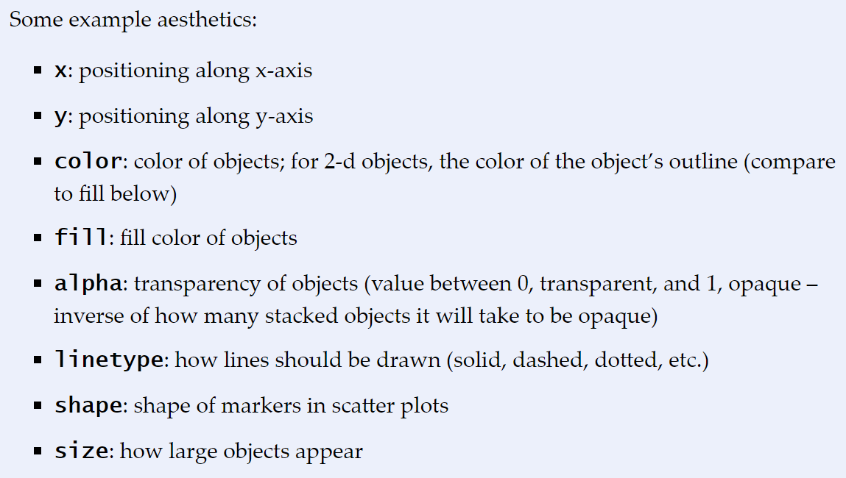
From: https://stats.idre.ucla.edu/r/seminars/ggplot2_intro/

Slide 17
Syntax: Geoms
Geoms are standard plot elements that we are used to using for displaying data
Each geom function accepts a subset of the aesthetics available

Slide 18
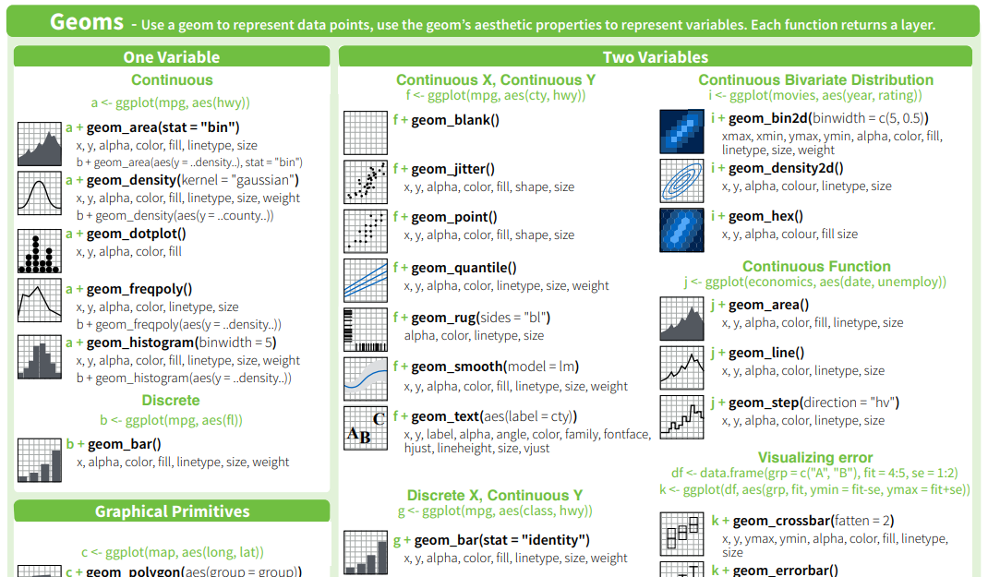
From the ggplot2 cheat sheet (included with workshop materials). From: https://www.rstudio.com/wp-content/uploads/2015/03/ggplot2-cheatsheet.pdf
Notes:
Note the features that geom_point offers: x, y, alpha, color, fill shape, size.

Slide 19
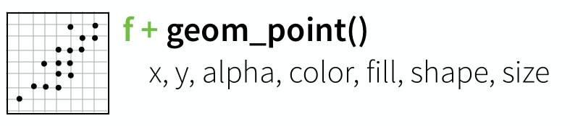
Notice what physical features of a plot geom_point() makes available for data…
From the ggplot2 cheat sheet (included with workshop materials). From: https://www.rstudio.com/wp-content/uploads/2015/03/ggplot2-cheatsheet.pdf
Notes:
Note the features that geom_point offers: x, y, alpha, color, fill shape, size.

Slide 20
Syntax
All of your data needs to be in a single data frame for simple plots
You may need to restructure your data a bit to make things work
Much of the tidyverse collection of R packages were made to make this easier
We only have time to just touch on the tidyverse today, if you are interested there is a lot of information available online (it is very powerful)

Slide 21
Simple Examples

Slide 22
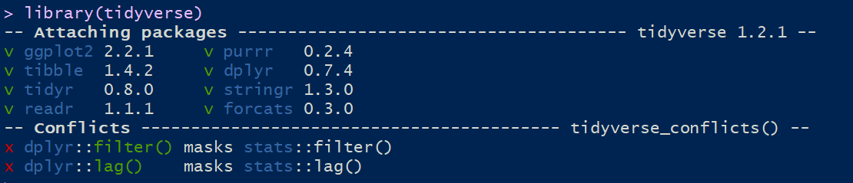
library(tidyverse)
Loading the tidyverse basically configures R to use the “tidy” data format:
Rows are data “points” (subjects, observations, units, etc.)
Columns are variables observed on units
The tidy format is a “tall” data format: if you have multiple observations on a unit, each observation has its own row!
The tidyverse us a collection of tools to make this format easy to achieve and maintain as you process your data set.

Slide 23
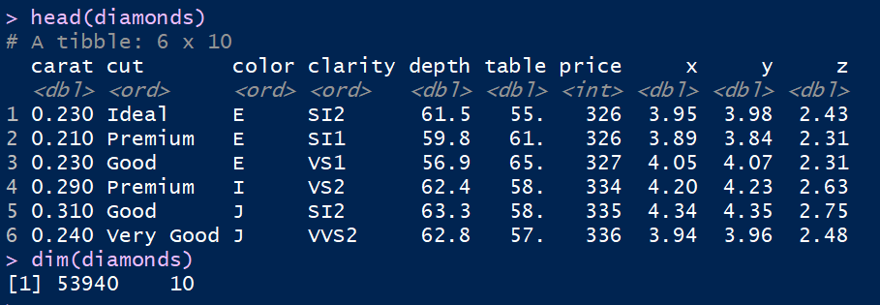
library(tidyverse)
data("diamonds")
head(diamonds)
dim(diamonds)

Slide 24
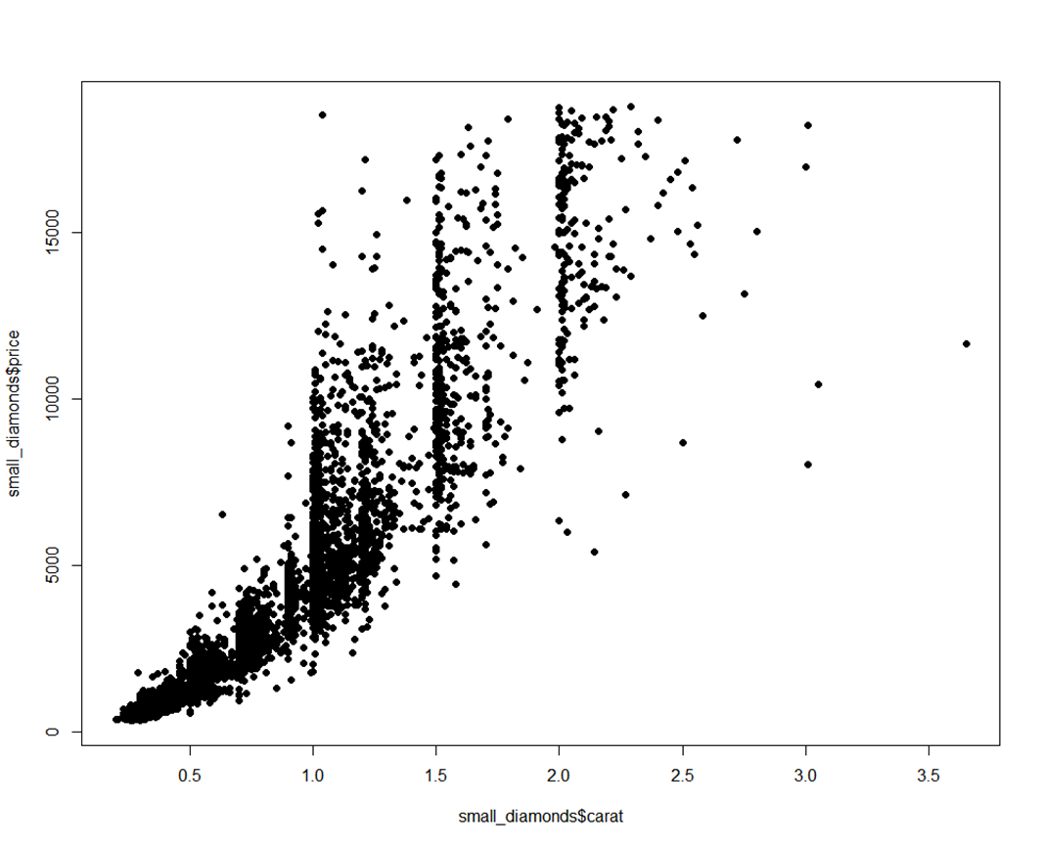
small_diamonds <- sample_n(diamonds, size = 5000)
plot(small_diamonds$carat, small_diamonds$price, pch = 16)
This plot command is a base R graphics command and the sort that most people should be familiar with using. The output is fairly simple but we could add more nice features.
Notes:
Sample_n is from dplyr
Dataset $ variable name

Slide 25
How would this go in ggplot2?
We begin by calling the ggplot command (no 2!) and setting our data source and baseline aesthetic

Slide 26
pvc <- ggplot(aes(x = carat, y = price), data = small_diamonds)
pvc
“aes” for aesthetic
In R, there are two ways to give variables to functions:
List them in order (like with the previous plot command)
Specify them by name (as done here)

Slide 27
How would this go in ggplot2?
We begin by calling the ggplot command (no 2!) and setting our data source and baseline aesthetic
Notice:
No plot is made, but the axes are computed based on the data set
The first line sets the aesthetics and data
The second line shows the plot (just pvc – the name of the plot!)
To actually make a figure, we need to add a “geom” (geometry or geometric object)
ggplot builds plots by adding together different plot objects

Slide 28
pvc <- ggplot(aes(x = carat, y = price), data = small_diamonds) +
geom_point()
pvc
So for a really simple figure, ggplot is a little more complicated to start, but we get some nice features for free:
Axis names are cleaner
The grid background is visually helpful

Slide 29
It is worth noting that there is really nothing that you can do with ggplot that you cannot do with base R graphics, but doing those things can take a lot of code.
Base R Graphics
ggplot2

Slide 30
The critical benefit of ggplot appears when you go beyond a basic plot
For this example, let’s add the cut of the diamond to the plot
In ggplot this is very easy…

Slide 31
pvc <- ggplot(aes(x = carat, y = price), data = small_diamonds) +
geom_point(aes(color = cut))
pvc
The only change here is to add a new aesthetic relating the color of the points to the variable “cut.”
Notice that the plot region is shaped a little differently due to the legend being added for the colors.
We can change this by adding a size specification to the region.

Slide 32
plot(small_diamonds$carat, small_diamonds$price,
col = small_diamonds$cut, pch = 16)
legend("bottomright", legend = unique(small_diamonds$cut),
col = 1:length(small_diamonds$cut), pch = 16)
Base R Version

Slide 33
Specifying and Modifying Aesthetics
Notice that these two commands make the same plot:
So there are various places to specify aesthetics
You can also change aesthetics as you add layers
pvc <- ggplot(aes(x = carat, y = price), data = small_diamonds) +
geom_point(aes(color = cut))
pvc <- ggplot(aes(x = carat, y = price, color = cut), data = small_diamonds) +
geom_point()

Slide 34
Alternative Specifications of aes()
There are various equivalent ways of specifying the aesthetic mappings as shown on the following slides…

Slide 35
mpg_plot <- ggplot(mpg, aes(displ, hwy, color = class)) + geom_point()

Slide 36
mpg_plot <- ggplot(mpg, aes(displ, hwy, color = class)) + geom_point()
The Data Set
The x and y variables in order

Slide 37
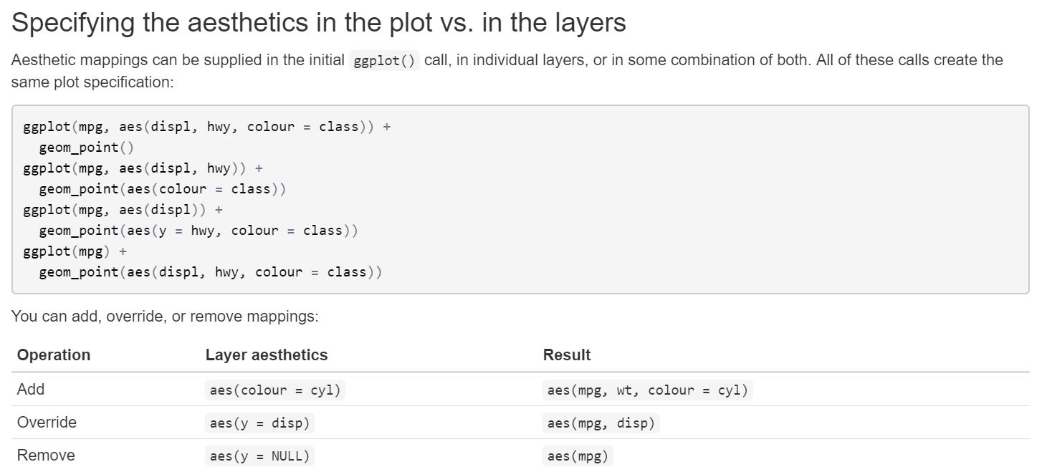
Notice that ggplot2 accepts both British and American spellings of color.
https://rpubs.com/hadley/ggplot2-layers

Slide 38
R Example File
We will now continue inside the R file: overview_of_ggplot2.R

